Slide 1
.
Brain-Computer Interfaces
In Quadriplegic Patients
.

Slide 2
.
Our Team
Name
ID
. | .
Sara Anis Halim | 18003
Ahmed Gaber Rhouma | 18044
Omar El-Sool | 18183
Amira Hisham Momen | 18194
Ibrahim Ayman Abu-Shara | 18011
Hazem Akram | 18127
Mohamed El-Bordiny | 18068

Slide 3
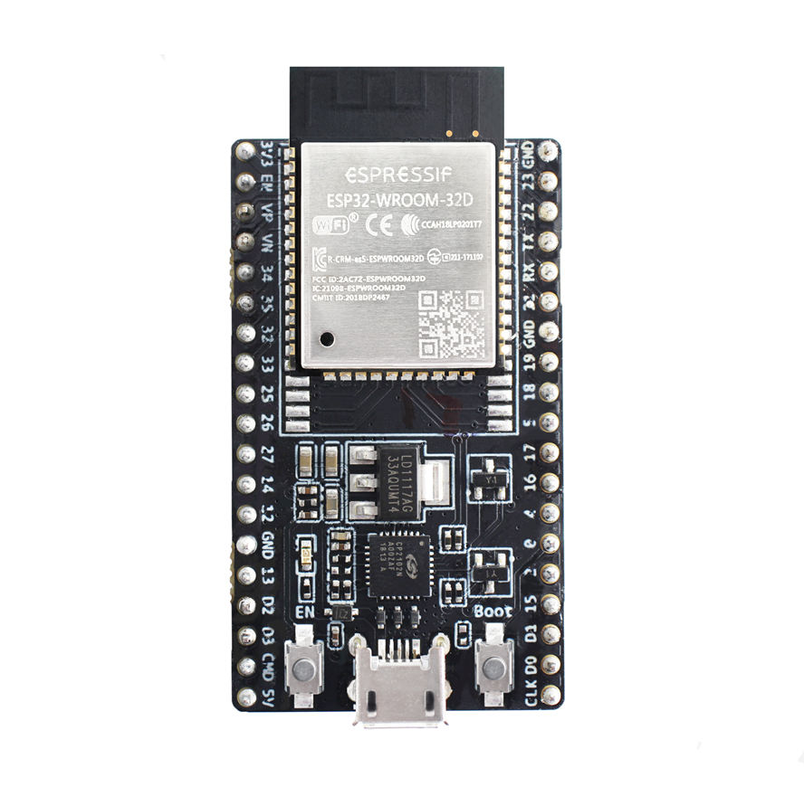





.
The project
Signal processing
Split
blinks
ML
Streaming Data
Decision
(Normal , forward,
right , left)
Control
Human brain
Server
MC
Wheelchair Prototype

Slide 4
S-EEG Sensor
Streaming Data
Human brain
Server

Slide 5

EEG Sensor
Mercury
Planet Mercury is the closest object to the Sun
(electroencephalography)
It is a test used to evaluate the electrical activity in the brain.
Brain cells communicate with each other through electrical impulses.
Scalp EEG recording displays the difference in electrical potentials between two different sites on the head
Mars
Despite being red, Mars is a cold place
Jupiter
Jupiter is a gas giant and the biggest planet

Slide 6
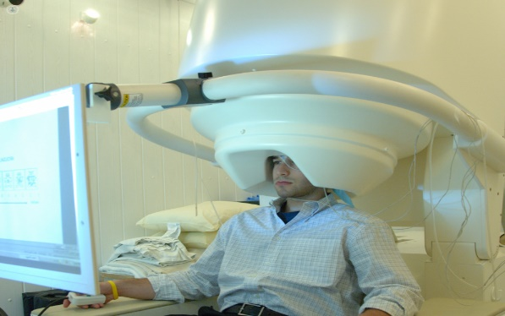
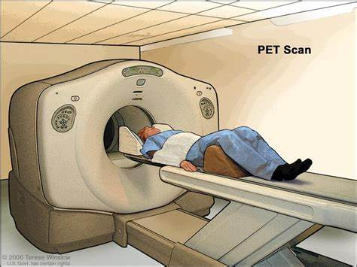
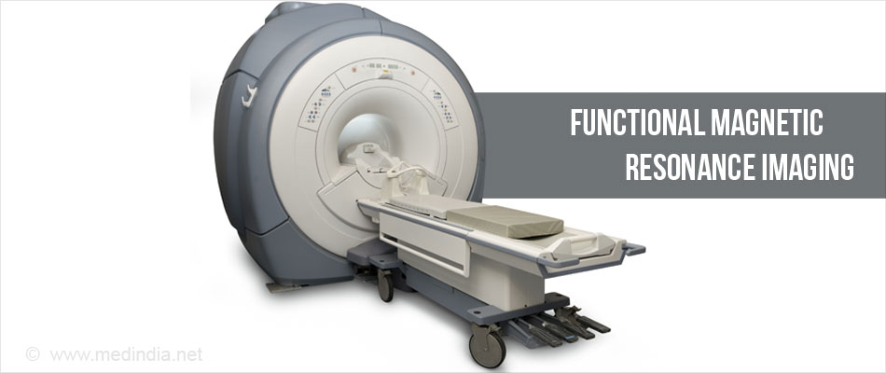
EEG compared to other brain imaging techniques

Slide 7
EEG Advantages
Choose EEG techniques despite the existence of better devices than other techniques.

Slide 8
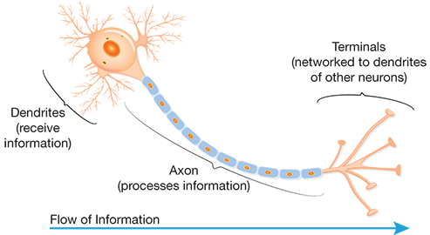
The Brain and Biological Neural Network
01
The billions of neurons in the human brain have highly complex firing patterns
Every interaction between these active neurons creates a minimal electrical discharge, which creates different amplitude and frequencies
02
03
Action potential

Slide 9
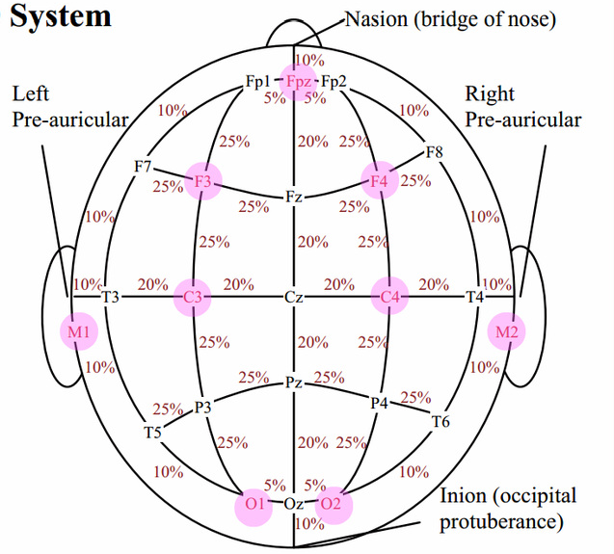
The Ten-Twenty System
The international ten-twenty System of Electrode Placement uses on the Scalp to take signal.
Each Channel name begin
It begin with one or two letters indicating to the general brain region
Each Channel name end
It is ended by the numbers that indicating the distance between channel and middle of the brain

Slide 10
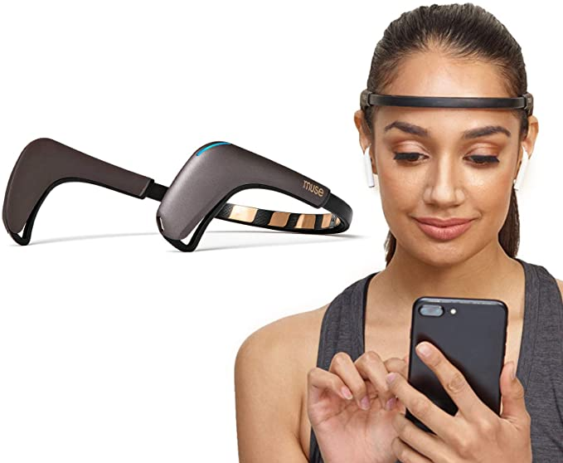
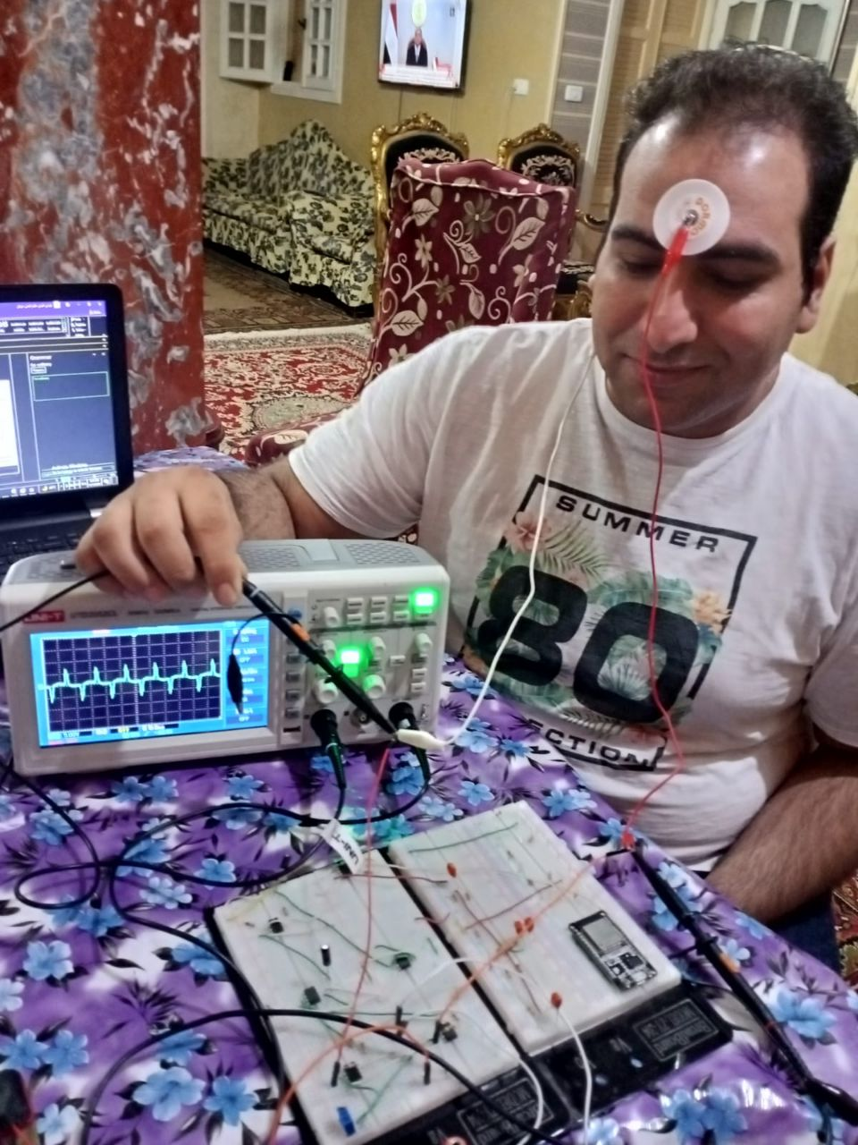
Muse & S-EEG Sensor
01
Muse
S-EEG Sensor
02

Slide 11
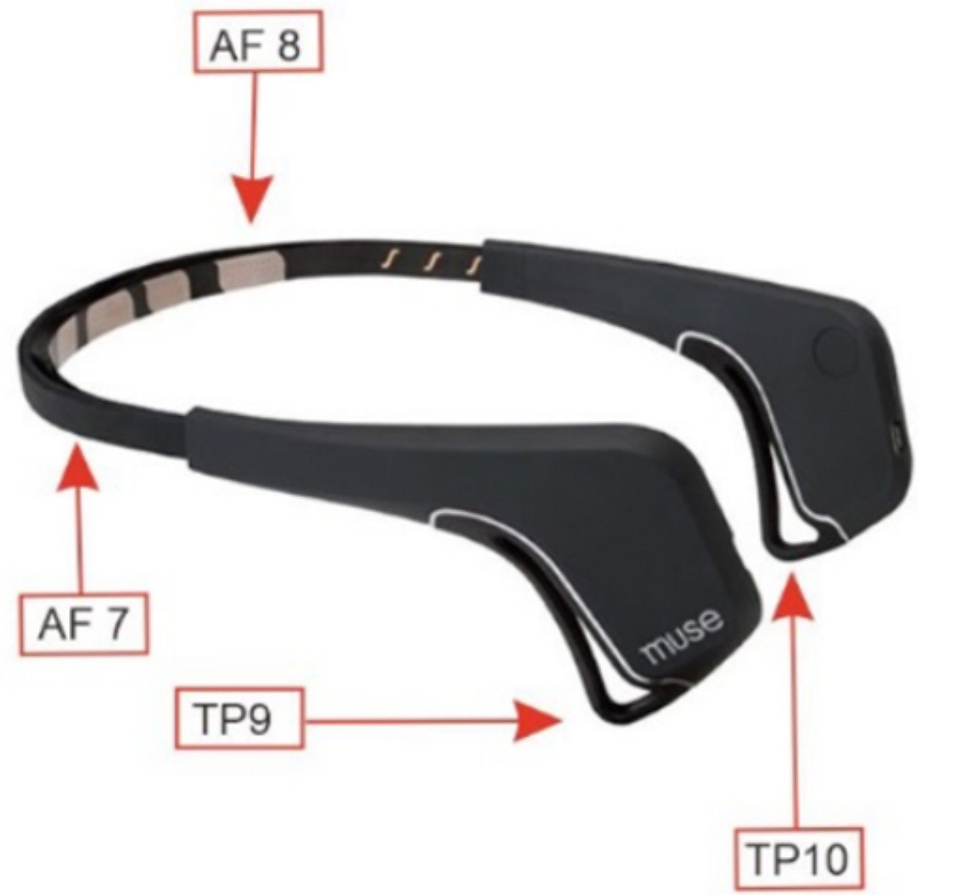
Muse Headset
01
Muse Channels
Muse based on EEG Technique
02
03
Channels locations
Muse advantages & disadvantages
04

Slide 12
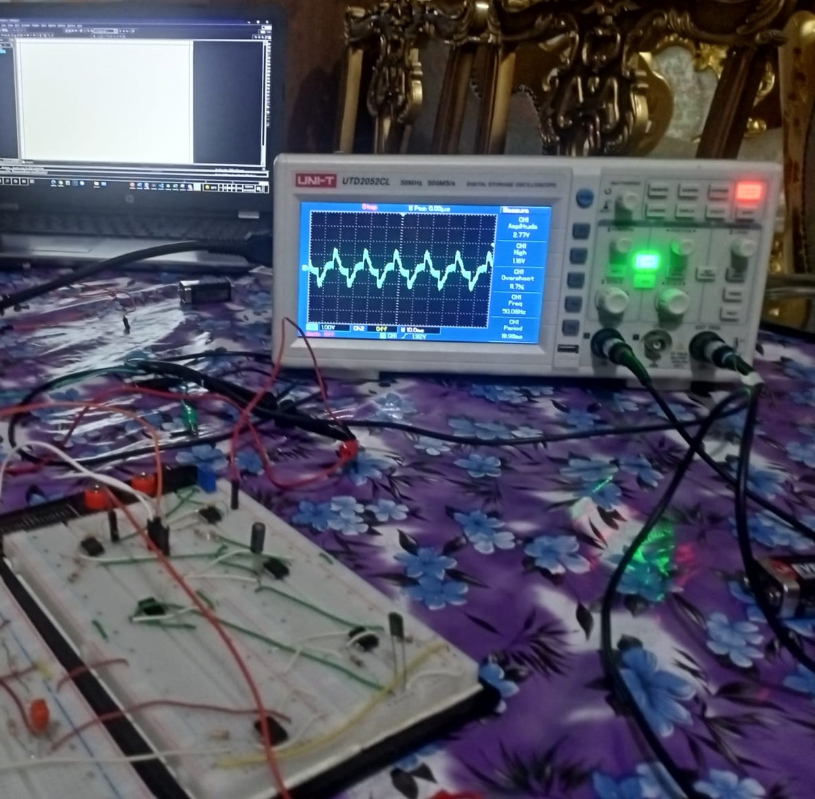
S-EEG Sensor
S-EEG Sensor channel TP10, FPZ
S-EEG Sensor Advantages
S-EEG Sensor output

Slide 13
Sensor Components
amplifer
Filters
01
02
Because the signal is very small in mv
Because the signals is very noisy.
Notch Filter
ADC
03
04
To block 50 Hz
To deal with the signal

Slide 14
Input & output of each step
Electrical waves in mv
amplification Electrical signal
Must be in range to pass
Continuous analogy electrical signal
Electrical
Waves from
brain
Electrodes
Amplifier
Filters
ADC
After ADC, analogy signal convert to Digital values
Amplifition Electrical signal
Signal is amplifiered and filtered
Electrical waves

Slide 15
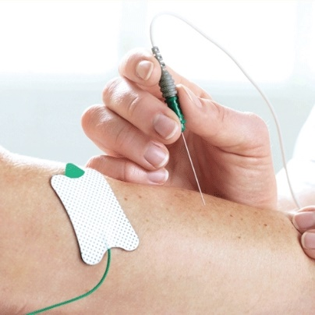
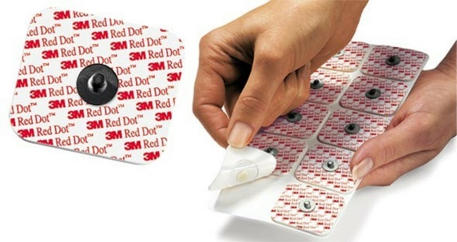
Electrodes
01
02

Slide 16
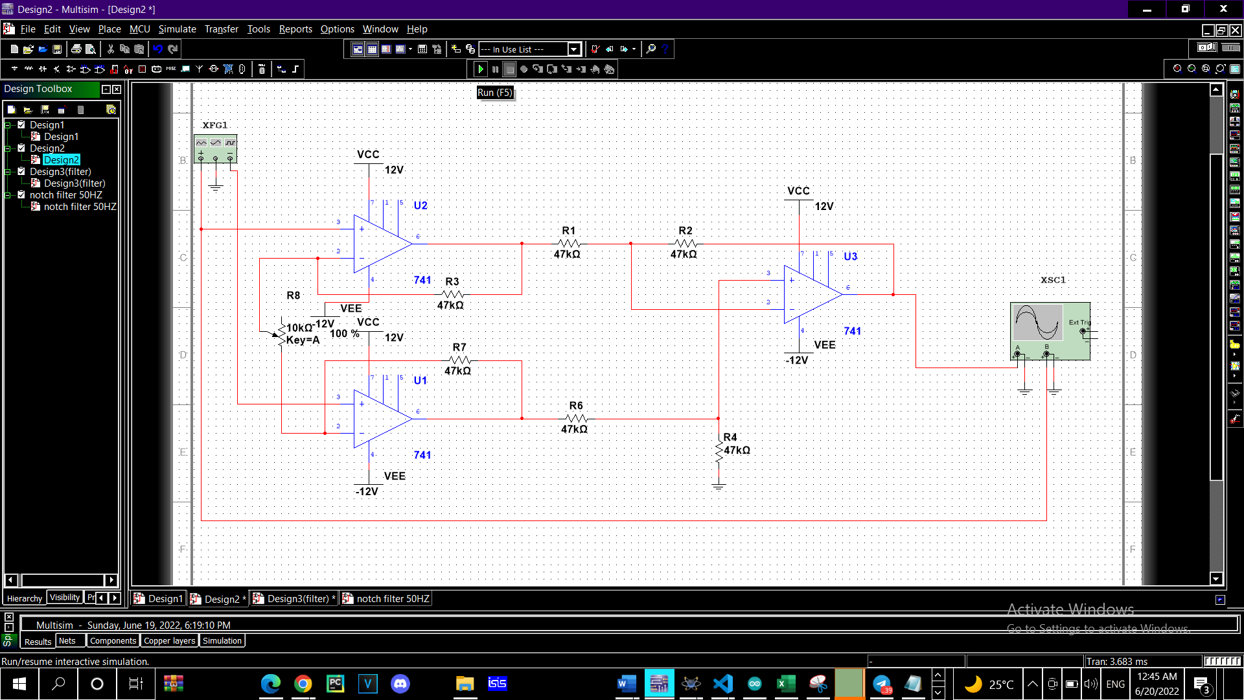
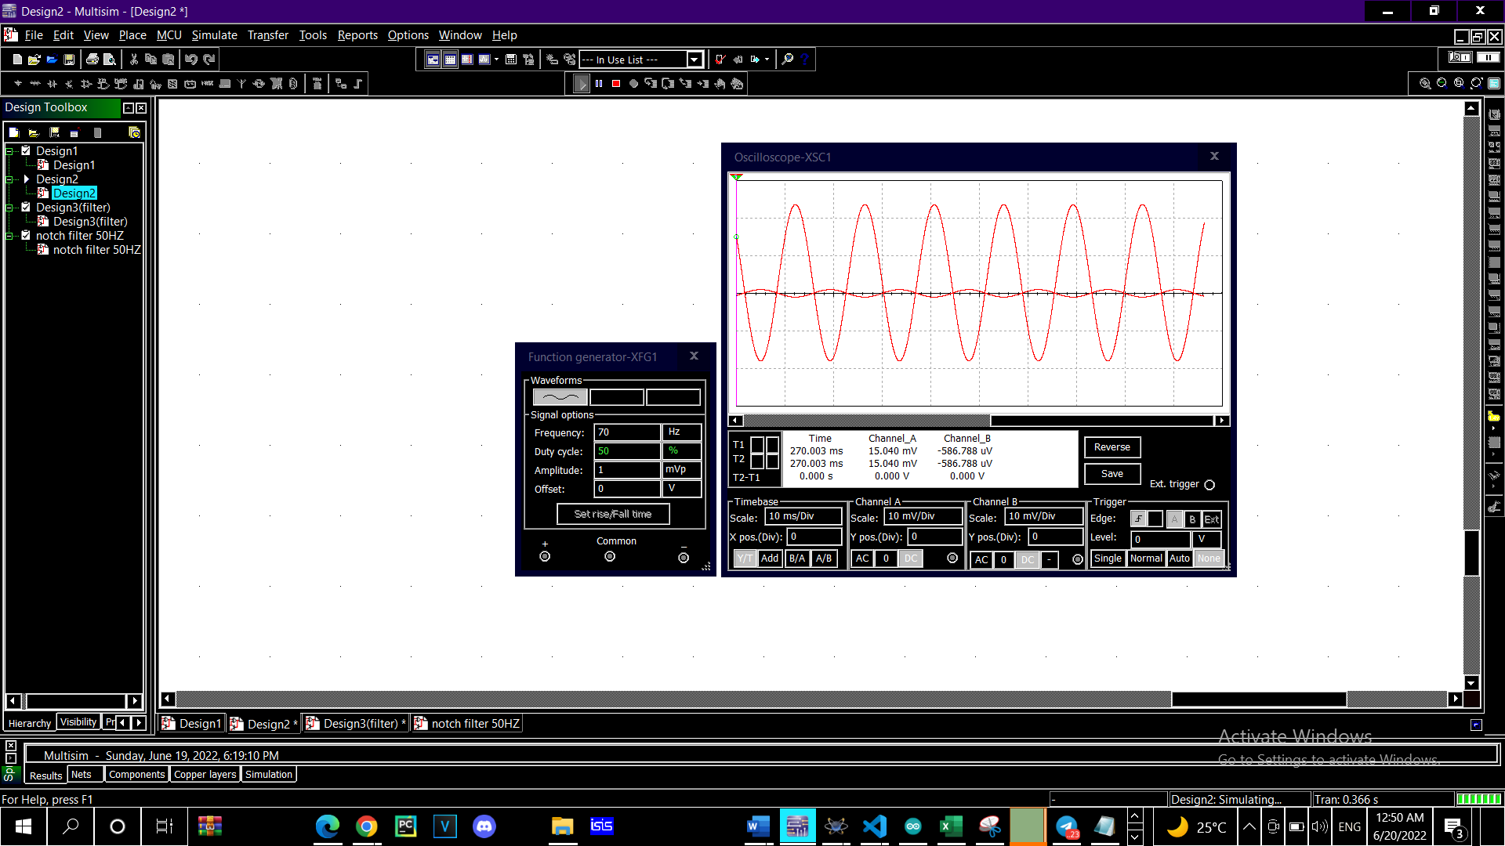
Amplifier
The Final Output of instrumentation Amplifier
The instrumentation Amplifier that is extension of the difference amplifier (amplifies the difference between its input signals)

Slide 17
Filters
Band Pass Filter:
To control in range that we need
From 1.5 hz to 318 hz
01
Notch Filter:
To block 50 Hz from our frequencies band
02

Slide 18
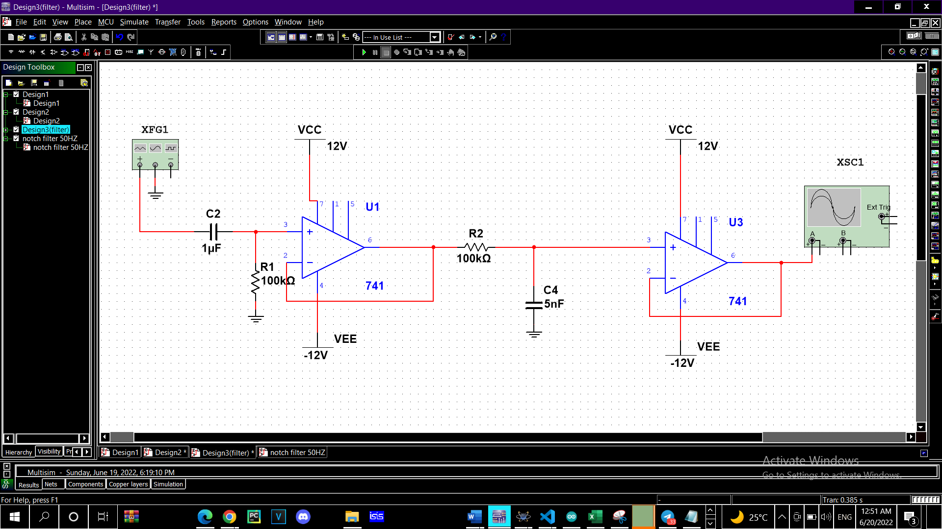
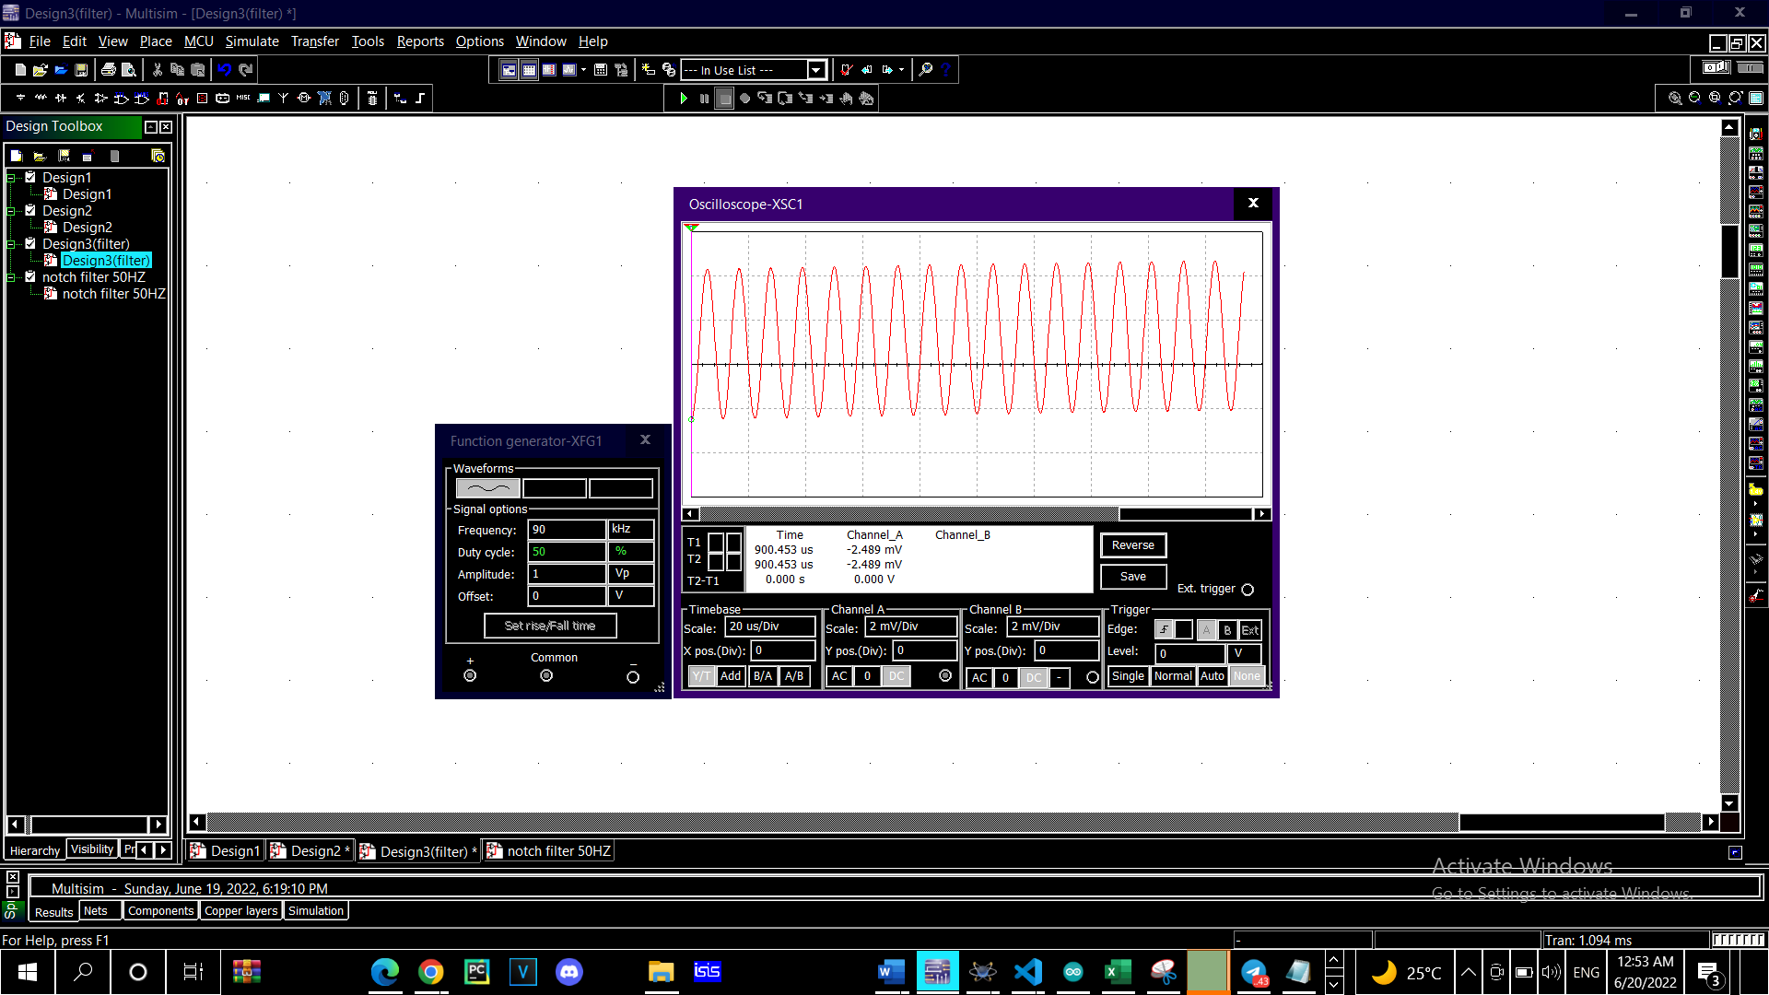
Filter(Band Pass Filter)
The Final Output of Band pass Filter
Band Pass Filter is used to detect range that we need From 1.5 HZ to 318 HZ

Slide 19
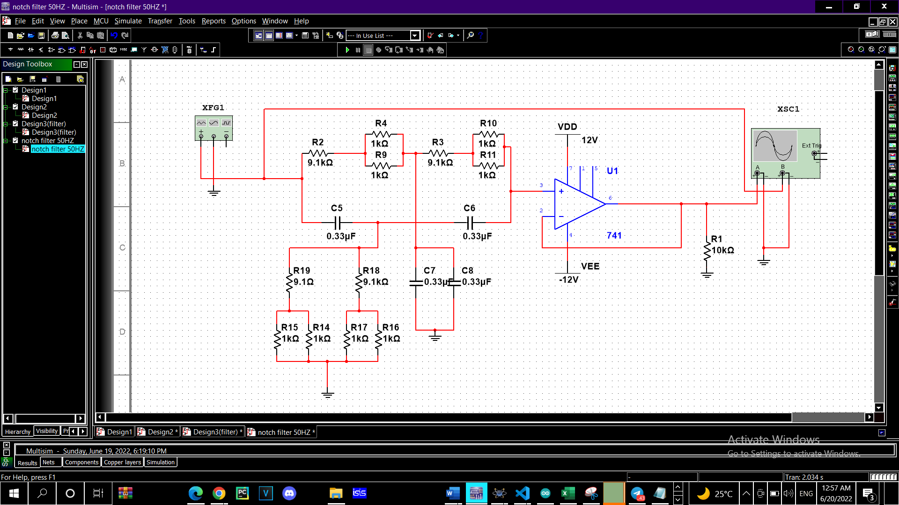
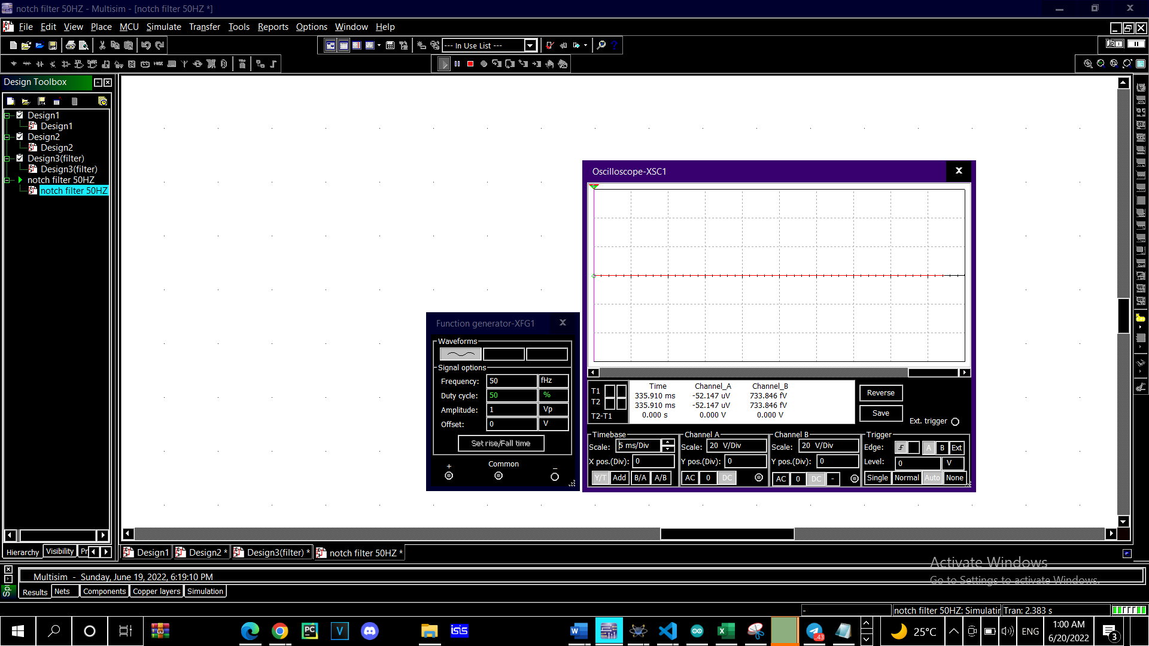
Notch Filter
Notch Filter used to block 50 HZ
The Final Output of Notch Filter

Slide 20
Design Implementation
BreadBroad
01
02
PCB

Slide 21
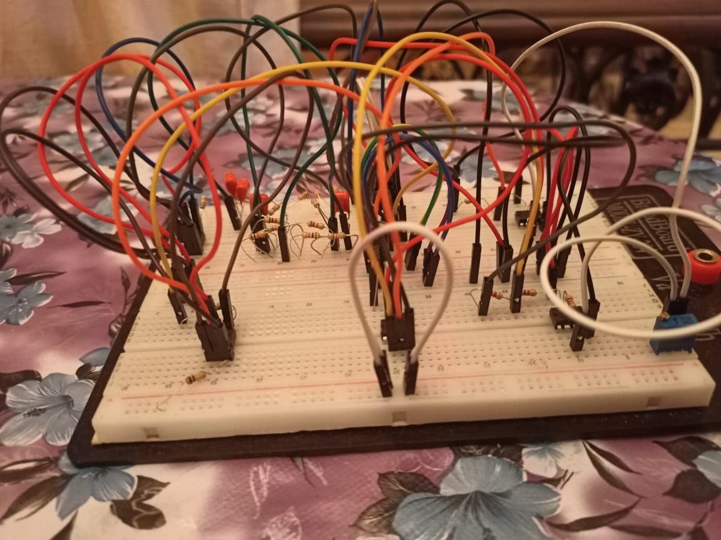
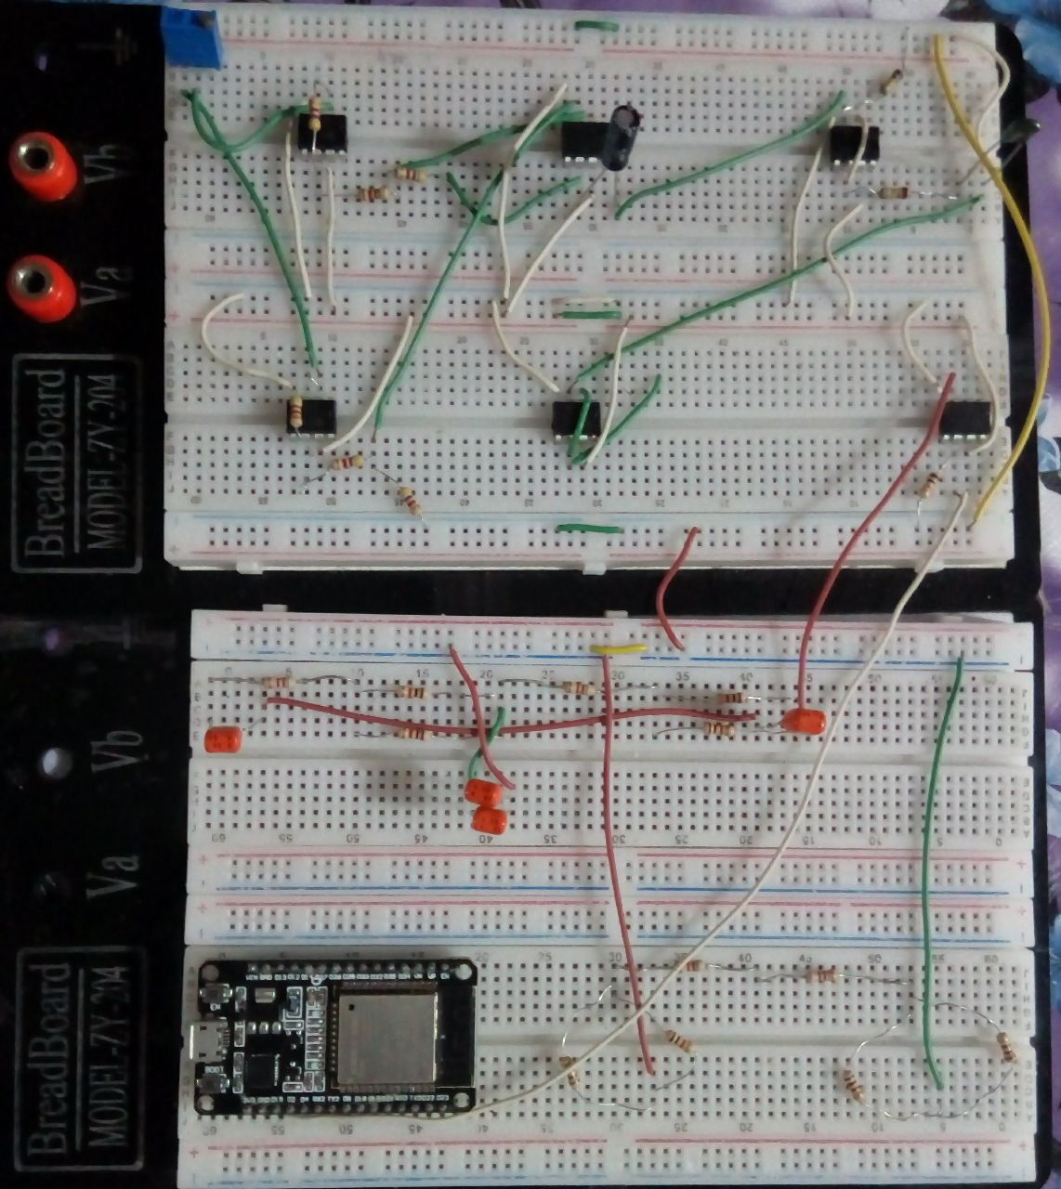
BreadBroad:
01
02

Slide 22
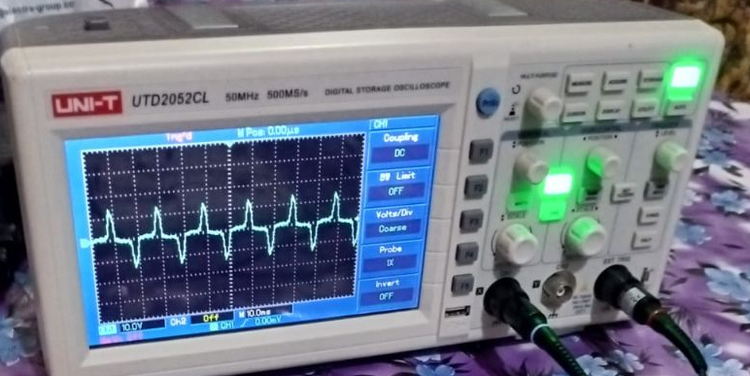
The output of S-EEG Sensor
TP10
FPZ
The output of eyes blink

Slide 23
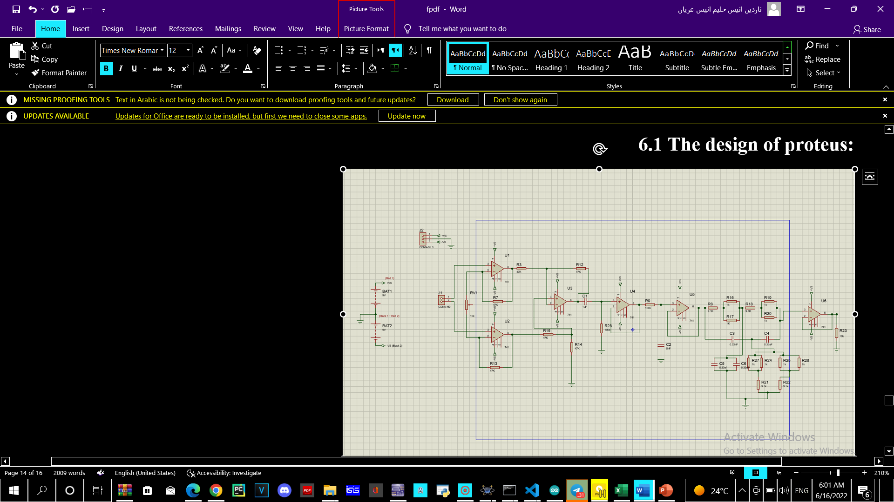
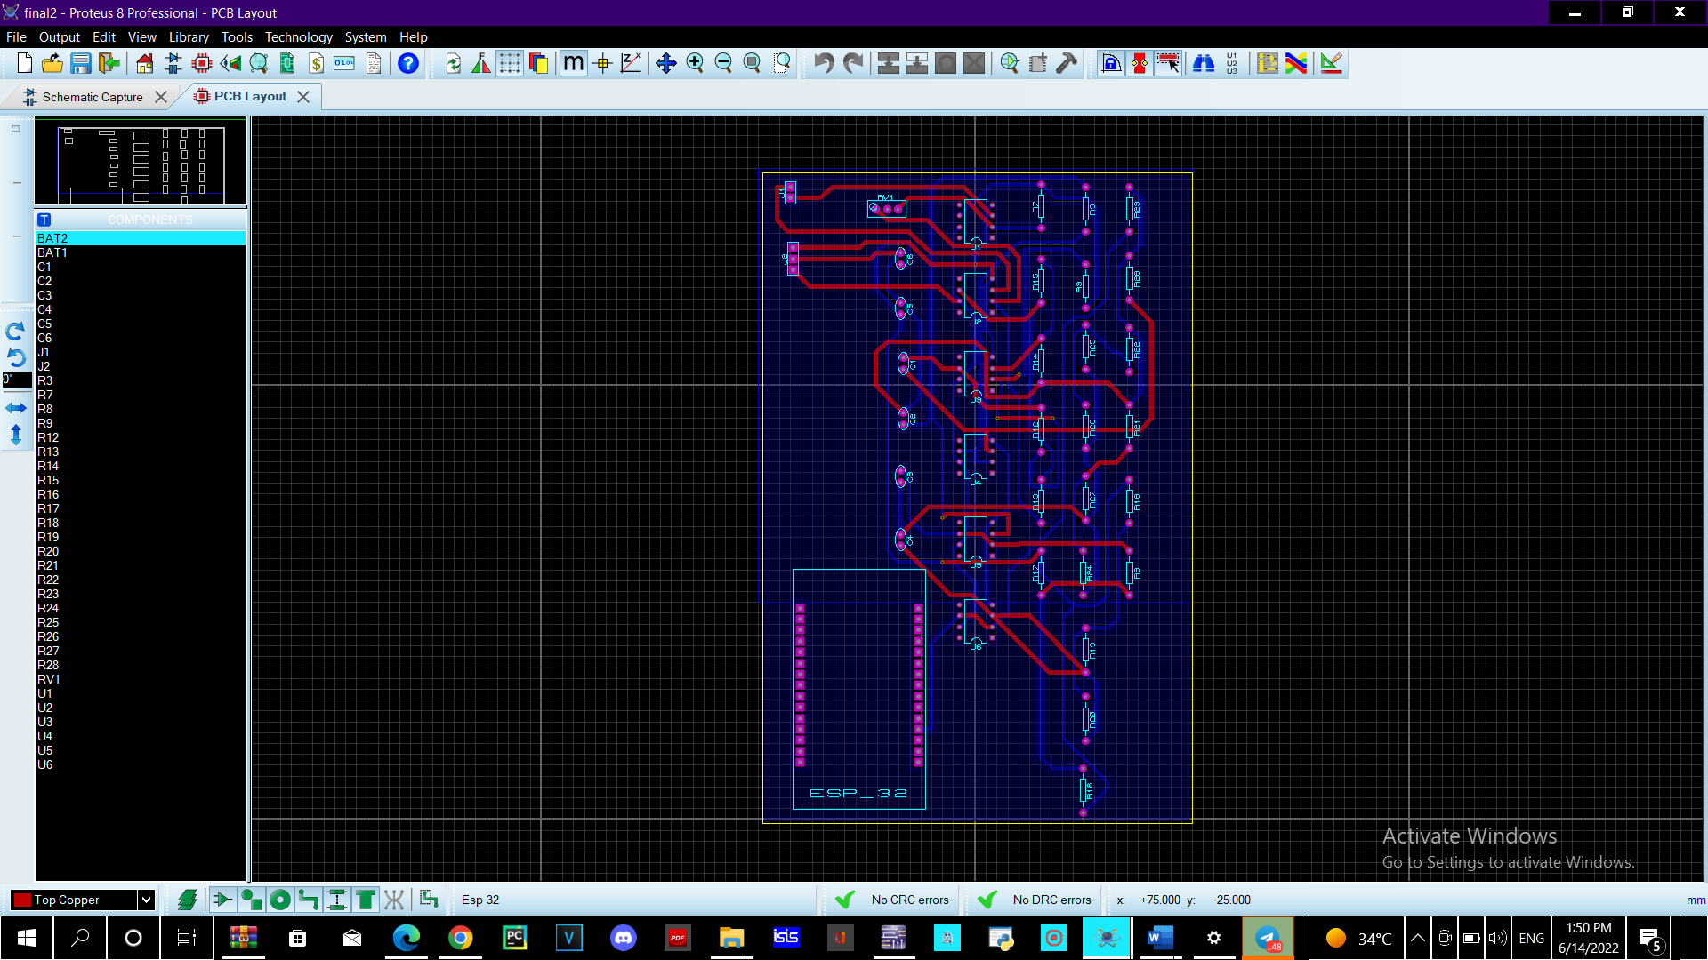
The Design of PCB and The rooting of PCB
01
Proteus design
02
Proteus design

Slide 24
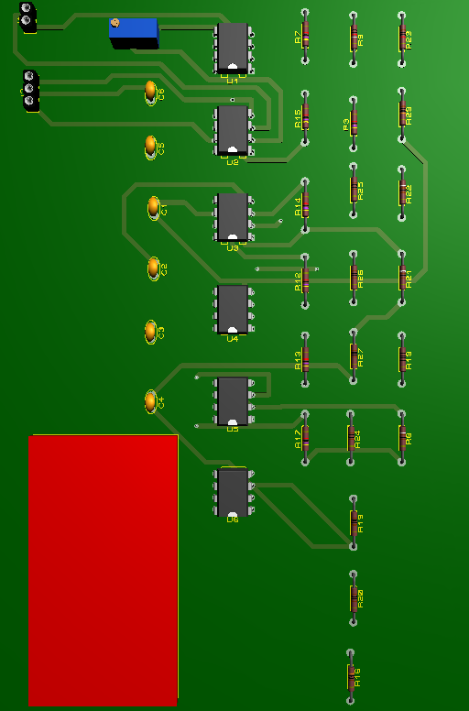
03
PCB

Slide 25
ADC
it uses to convert the analogy continuous electrical signal to digital to enable us to use it and deal with signals coming from the brain.
numbers
ADC

Slide 26
Signal
Processing
Signal processing
Streaming Data
Server

Slide 27
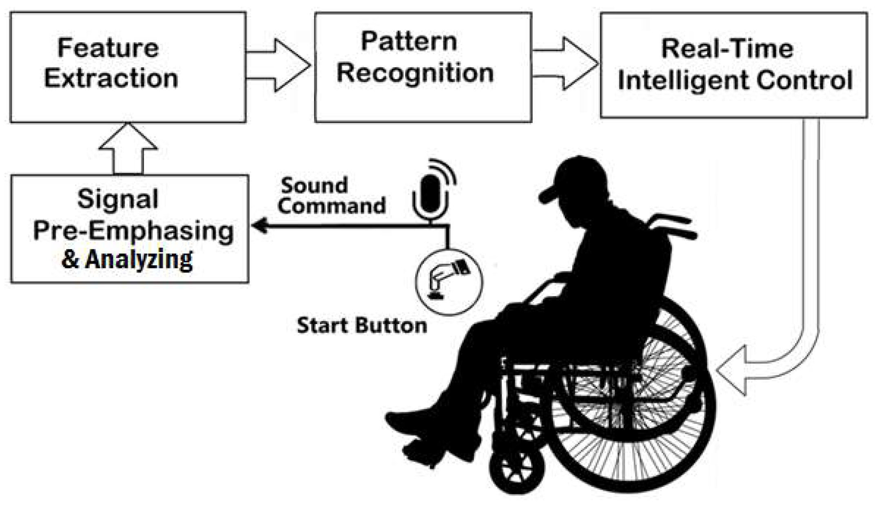
.
Signal Processing
Real Time Intelligent Control System
Analysis
Pattern Recognition
Raw Data

Slide 28
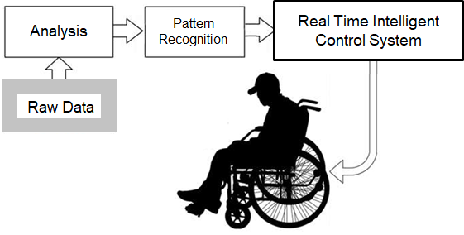
0
Signal Processing
Requirements And Design

Slide 29
Requirements
Search & Connect
01
02
Graph the microvolts data for 4 channels
04
03
Record data for
machine learning
make dynamic threshold

Slide 30

GUI Design

Slide 31
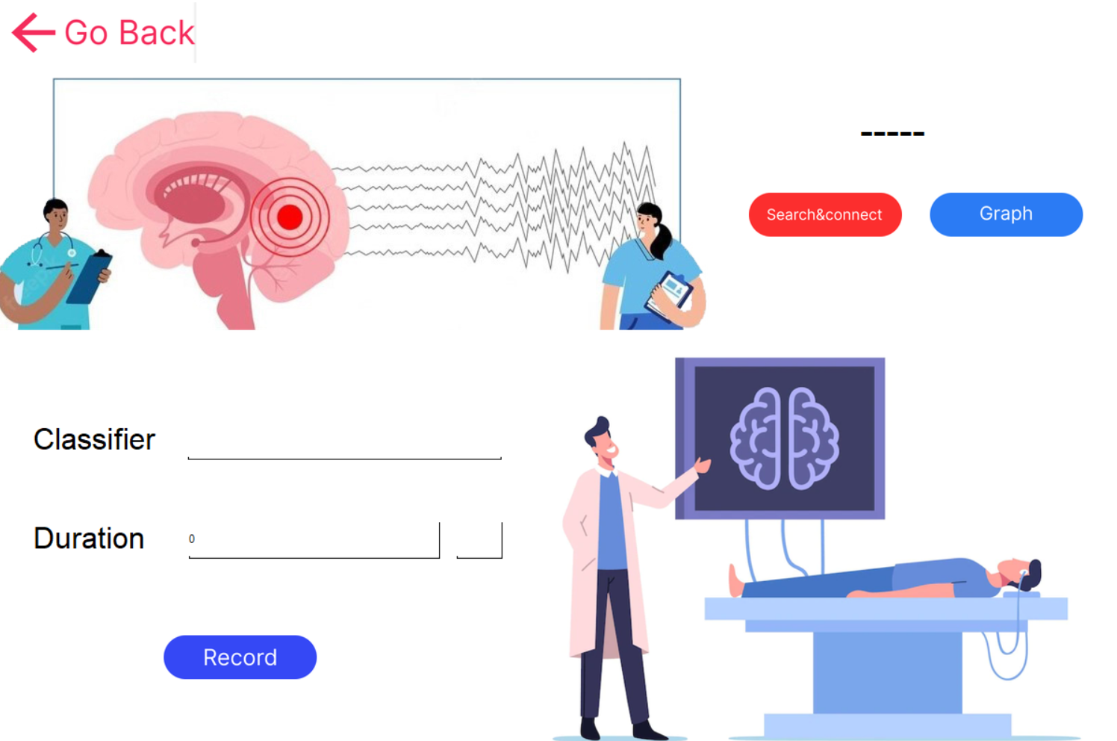
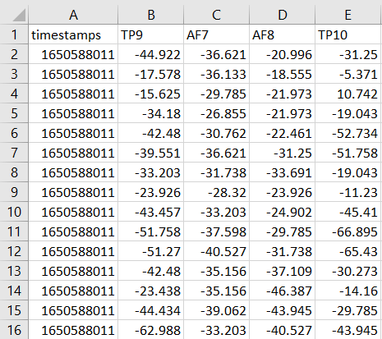
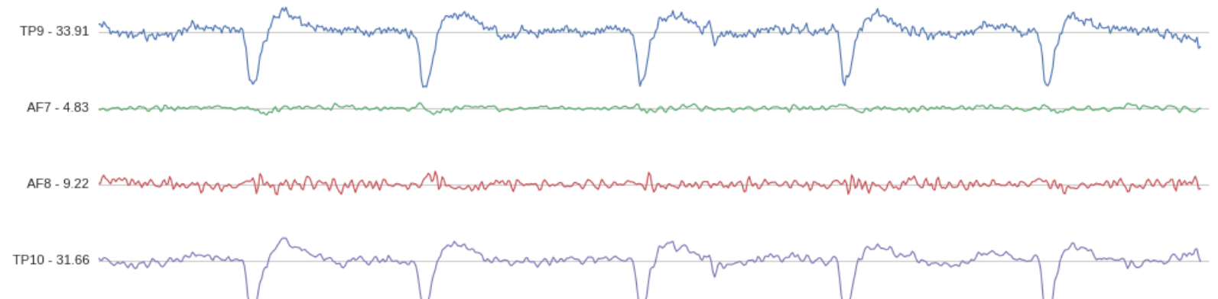
Interface

Slide 32
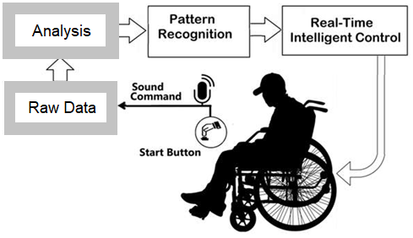
0
Signal Processing
Analysis For Blink Detection

Slide 33
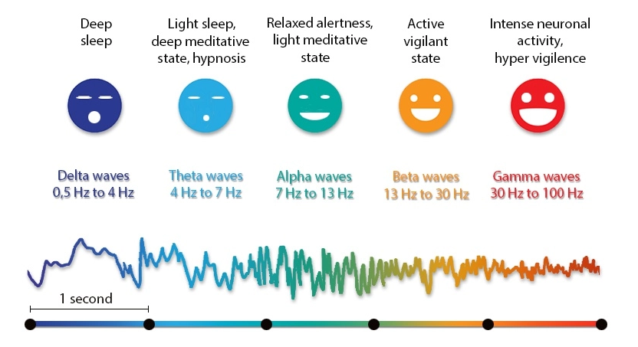
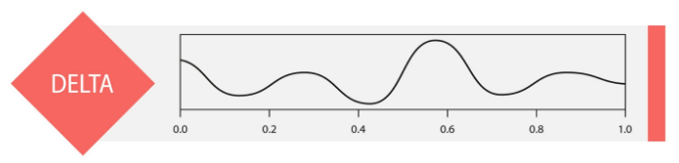
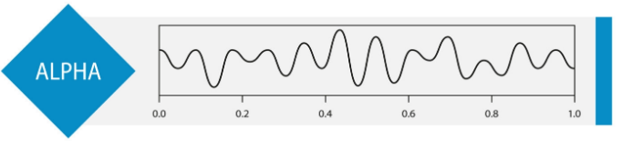
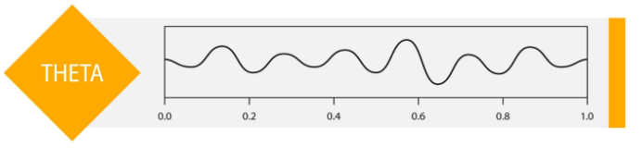
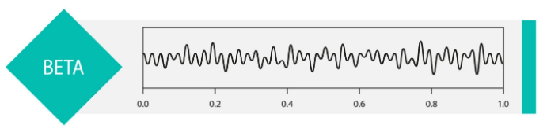
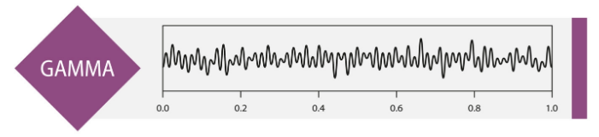
Frequency Band

Slide 34
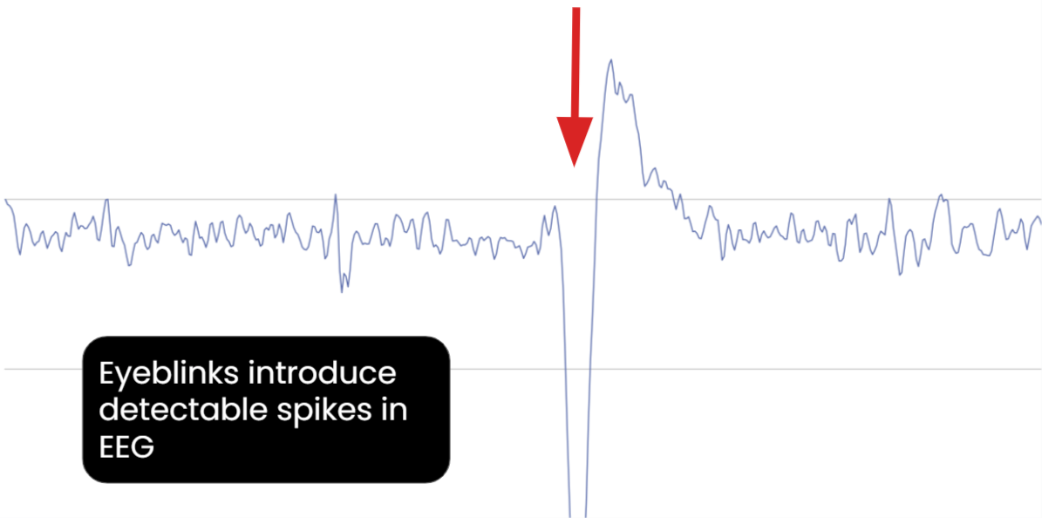
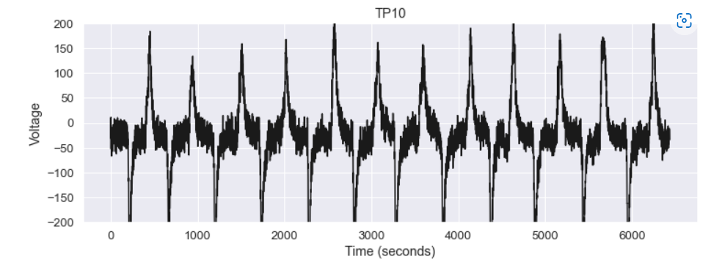
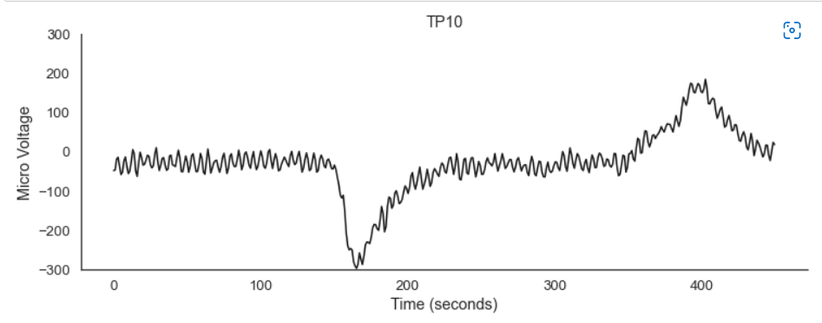
Eyeblinks in microvolts
Microvolts data for blinking 12 times

Slide 35
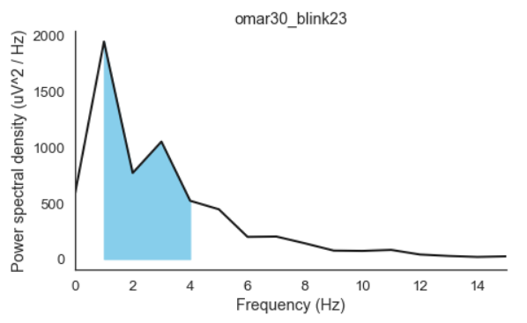
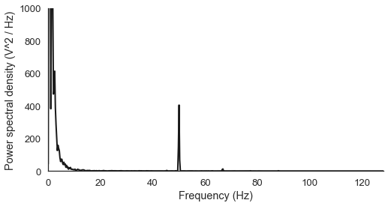
Frequency Domain Analysis
Frequency graph for the same data

Slide 36
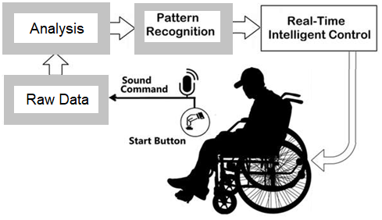
0
Signal Processing
Adaptive Threshold

Slide 37
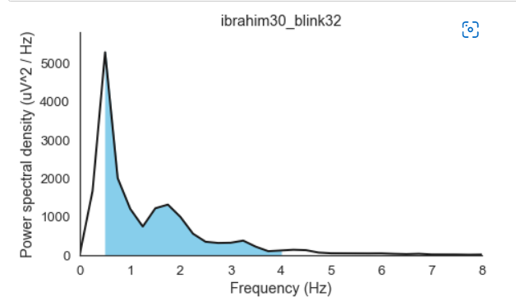
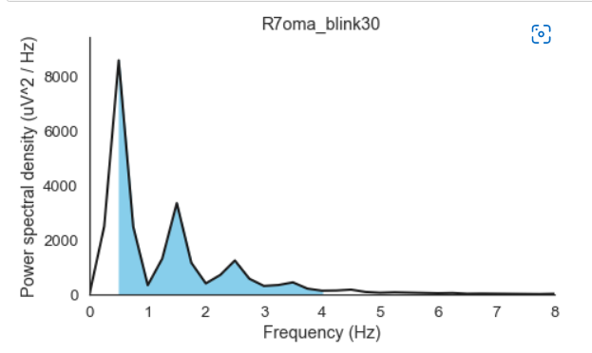
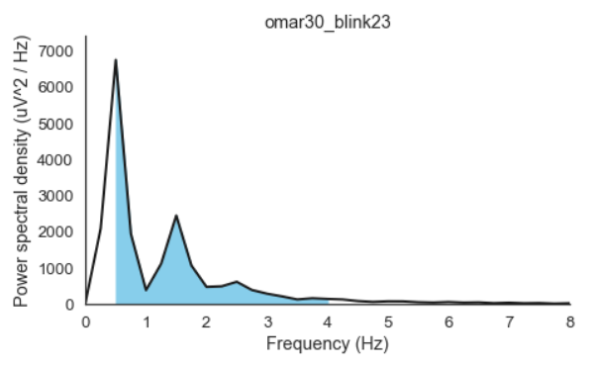
Unstable Delta
File 1
File 2
File 3
Peak: 5000
Peak : 8000
Peak : 7000

Slide 38

Add New Section

Slide 39
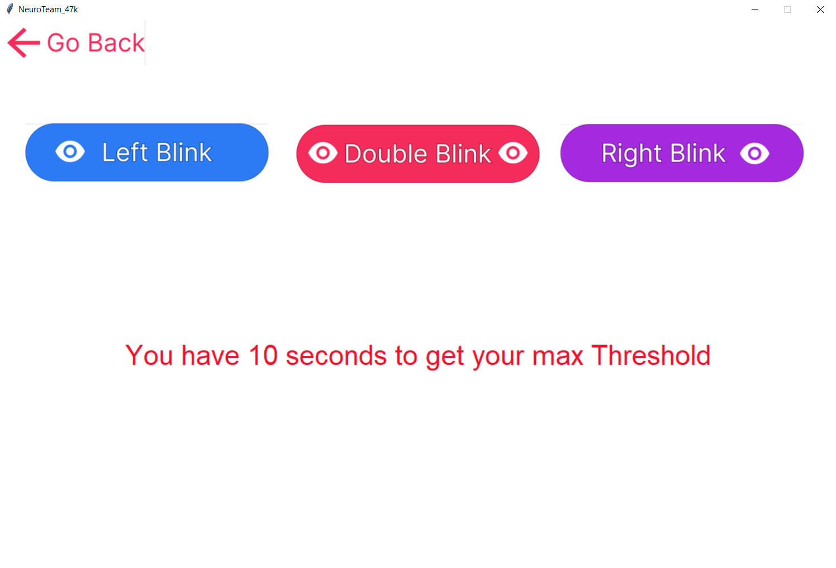
Dynamic Threshold

Slide 40
0
Signal Processing
Real Time Intelligent Control System
Analysis
Pattern Recognition
Raw Data
from Muse

Slide 41
0
Signal Processing
Event-Related Potential
ERPs are those EEGs that directly measure the electrical response of the cortex to specific events.
Sensory
Motor : Related to (BCI )
ERP : large number of action potentials (APs) that are Time Locked.

Slide 42
0
Signal Processing
Eyeblinks in microvolts
blinking for 12 times
m volt
Time (ms)

Slide 43
0
Signal Processing
Signal Processing
Real Time Signal Processing
1 ) Brain Wave Classification ➔ Frequency Domain Analysis ( DFT )
2 ) Event-Related Potential ➔ Time locked
So , our system needs Time-Frequency Analysis ( STFT )

Slide 44
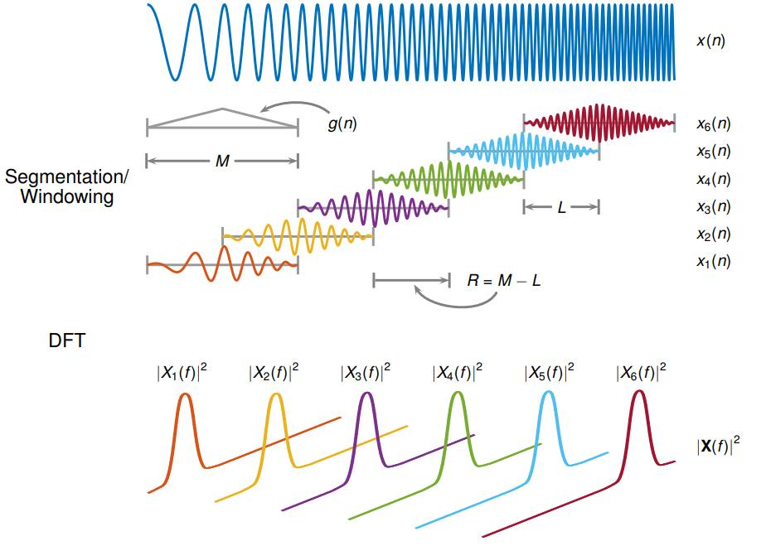
Short Time Fourier Transform
0
Signal Processing
Signal Processing
New Parameters
- g(n) : Window Equation
- M : Window Length
- L : Overlapping Length
- R : Shift Length
Buffer equation :
(Buf_Length - Epoch_Length) / Shift_Length + 1

Slide 45
Computational aspects
0
Signal Processing
Signal Processing
DFT : for a signal with T points, this takes approximately ${ ( T}^{2} )$ arithmetical operations
Which will be slow with large T
So we will implement DFT using Fast Fourier Transform implementation
FFT Applying Divide and Conquer strategy , running in time approximately ( T log T )
which can result in huge savings in computation time

Slide 46
0
Signal Processing
Signal Processing
Real Time Control System

Slide 47
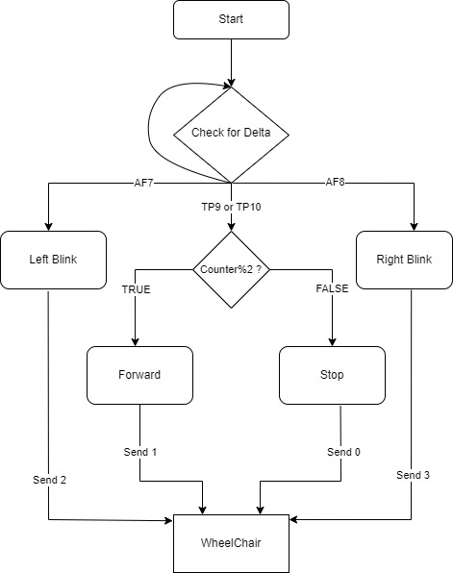

0
Signal Processing
Wheelchair movement flowchart

Slide 48
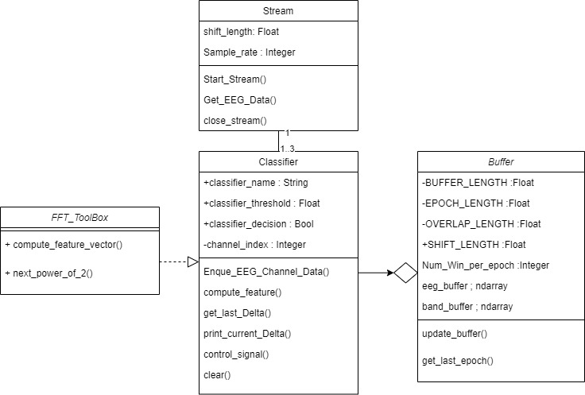
0
Signal Processing
Class Diagram

Slide 49
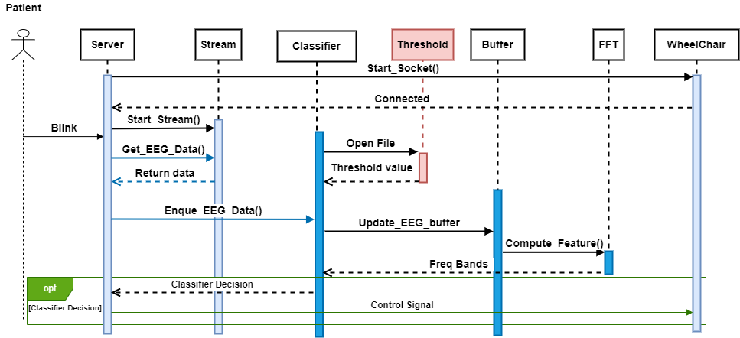
0
Signal Processing
Sequence Diagram

Slide 50
0
Signal Processing
Signal Processing
Real Time Intelligent Control System

Slide 51

0
Signal Processing
Class Diagram

Slide 52
Eye Blinking
&
Automation
Signal processing
Split
blinks
Streaming Data
Human brain
Server

Slide 53

0
Eye Blinking& Automation
Artifacts
Artifact on EEG is anything that does not arise from the brain itself.
Types of artifacts:
Electromyography(EMG)
Electrooculogram(EOG)

Slide 54

0
Eye Blinking& Automation
Bell's Phenomenon
It describes the reflex upward movement of the front of the eyeball when the eye blink. Because the cornea is positive and the retina is negative , this causes a deflection .

Slide 55


0
Eye Blinking& Automation
Muse electrodes localization
localization has been one of the primary goals of solving the inverse problem in EEG. What this means is identifying where in the brain a particular type of activity originates based on the surface EEG recording.

Slide 56

0
Eye Blinking& Automation
Polarity Rules
Input 1 more positive than Input 2 and conversely that Input 2 more negative than Input 1 : upward deflection
Input 1 more negative than Input 2 and conversely that Input 2 more positive than Input 1: downward deflection
Input 1= Input 2: no deflection (flat line)

Slide 57


0
Eye Blinking& Automation
Apply Polarity Rules on Muse2
When the blink happens the signal's polarity is positive at the electrode to which the cornea is moving.
Volt (µv)
Time (s)

Slide 58

0
Eye Blinking& Automation
Electrodes classify type of blinks
According to Muse electrodes localization and Polarity Rules:
Right Blink
Left blink
AF7
AF8
TP9 or TP10
Right Blink
Left blink
Double Blink
Double Blink
Double Blink

Slide 59



0
Eye Blinking& Automation
Why we do all of this ?
Data For Machine learning
Recording data:
Desktop application (BHI Muse)

Slide 60


Methods to record and split EOG data
0
Eye Blinking& Automation
Record and split by threshold
Get EOG data by mathematical method
Desktop application Recorder
Generates a CSV File contains EEG data of 4 chanels
Record and split by sound
Get EOG data by sound indicator

Slide 61


0
Eye Blinking& Automation
Record and split by threshold
mathematical method gets only blinks and discards anything else.
Volt (µv)
Time (s)

Slide 62

0
Eye Blinking& Automation
Steps to split:
Get the absolute :

Slide 63

0
Eye Blinking& Automation
Steps to split:
2. Clean the signal:

Slide 64


0
Eye Blinking& Automation
Steps to split:
3. Detect the threshold of eye blinks peeks:
In our first code we tried find the peek point using normal for loop
Then we found python library called Nerokit 2

Slide 65


0
Eye Blinking& Automation
Steps to split:
4. Get the original blink data :

Slide 66


0
Eye Blinking& Automation
2. Record and split by sound indicator
Big problem: threshold couldn’t recognize the pattern of blink because of EMG
Solution: 2 seconds sound as an indicator for the blink 1s close / 1s open

Slide 67
Deep
Learning
Signal processing
Split
blinks
ML
Streaming Data
Decision
(Normal , forward , right , left)
Human brain
Server

Slide 68
“Birds inspired us to fly, burdock plants inspired Velcro, and countless more inventions were inspired by nature. It seems only logical, then, to look at the brain’s architecture for inspiration on how to build an intelligent machine.”
Mercury
Planet Mercury is the closest object to the Sun
Mars
Despite being red, Mars is a cold place
Jupiter
—Aurelien Geron
Jupiter is a gas giant and the biggest planet

Slide 69
Table Of Contents
01
02
03
Motovation
Filtering
Pre-processing
04
05
Modeling
Deployment

Slide 70
02
Preprocessing & Filtering

Slide 71


Savitzky-Golay Filter
0
Deep Learning

Slide 72


From Raw Data to Row Data
0
Deep Learning

Slide 73

0
Deep Learning

Slide 74

0
Deep Learning

Slide 75

0
Deep Learning

Slide 76
03
Modeling

Slide 77
Double Eye Blinking Classification
0
Deep Learning

Slide 78



Double Eye Blinking Classification
0
Deep Learning

Slide 79


Double Eye Blinking Classification
0
Deep Learning
conv2D
conv2D
Fully Connected Layers
pooling
conv2D

Slide 80

Double Eye Blinking Classification : Feature Maps
0
Deep Learning

Slide 81


Double Eye Blinking Classification : Feature Maps
0
Deep Learning

Slide 82

Confusion Matrix
0
Deep Learning
 | ACC | PRED | SEN
Class 0 | 98.07% | 97.44% | 99.78%
Class 1 | 98.07% | 99.75% | 97.11%

Slide 83
Left / Right Eye Blinking Classification
0
Deep Learning

Slide 84



Left / Right Eye Blinking Classification
0
Deep Learning

Slide 85
Left / Right Eye Blinking Classification
0
Deep Learning
conv
conv
Fully Connected Layers
pooling
conv
pooling
conv

Slide 86


Left / Right Eye Blinking Classification : Feature Maps
0
Deep Learning

Slide 87


Left / Right Eye Blinking Classification : Feature Maps
0
Deep Learning

Slide 88

Left / Right Eye Blinking Classification
0
Deep Learning
 | ACC | PRED | SEN
Class 0 | 95.23% | 98.83% | 98.60%
Class 1 | 95.23% | 97.14% | 95.78%
Class 2 | 95.23% | 95.57% | 97.07%

Slide 89
Chair
Hardware
Signal processing
Split
blinks
ML
Streaming Data
Decision
(Normal , forward ,
right , left)
Control
Human brain
Server
MC

Slide 90

Introduction
Using microcontroller Esp32

Slide 91
What is the difference Esp32&Esp8266?
Esp32 | ESp8266 | Features
2016 | 2014 | Release year
Xtensa dual-core 32bit | Xtensa single-core 32 bit | Microcontroller
Up to 240MHZ | 80 MHZ | Clock frequency
ULP | × | Co-processor
✓ | ✓ | Wi-Fi
520KB | 160KB | SRAM
✓ | × | Bluetooth
25 | 13 | GPIO
15 | 1 | ADC
2 | × | DAC

Slide 92


How to build a server?
Connection modes :
SOCK_DGRAM (UDP)
Connection less
Unreliable
SOCK_STREAM (TCP)
Connection orianted
Reliable
Server

Slide 93
Building server
Socket
Client1
IP
port
Server
Thread
Start
Handle Client

Slide 94
Client attributes
Host IP
A computer data network assigns a number called an Internet Protocol (IP) address to every computer and device connected to it.
Port address
Every computer and mobile device runs many different internet-based apps, including email, web browsers and cloud storage drives. Each of these applications has one or more network “ports” assigned to it.

Slide 95
How Esp32 Works as a Client?
1
Forward
Wi-Fi
loop
Backward
IP
port
2
Right
Setup
Client
3
Left
4
Stop
5

Slide 96



Testing Car model
ESP32 with DC Motor and L298N Motor Driver Control Speed and Direction.

Slide 97



Wheelchair Components
Aluminum body
Two Power window DC motors
Battery 12 V – 9 Amp
Two bike Wheels 16″
Cytron Dual Channel 10A DC Motor Driver
--

Slide 98

Cytron Motor Driver Features
Bi-directional control for 2 brushed DC motor
Support motor voltage ranges from 5V to 30V
Maximum current up to 10A continuous and 30A peak for each channel
Speed control PWM frequency up to 20KHz
2 activation buttons for fast test on each channel

Slide 99

Wheelchair Simulation
(Simulation1.1)

